Slide 1

Topic :- IoT-based Smart Street Light System

Slide 2
INTRODUCTION
With increasing focus on smart cities and energy conservation, IoT-based solutions offer efficient ways to automate public infrastructure. Street lights consume a major portion of city electricity. Many times, they stay ON during daylight or when not needed, leading to energy wastage.
This project implements a smart street light control system using Python. It simulates a sensor-based street light system that turns lights ON/OFF based on real-time ambient light levels, optimizing electricity usage and saving power.

Slide 3
PROJECT DESCRIPTION
The system uses a simulated light sensor to measure ambient light levels. Based on a defined threshold, the program turns multiple street lights ON or OFF using conditional logic. The system also tracks electricity usage per cycle and generates a graph to visualize the energy consumed over time.
The solution is written in Python using Object-Oriented Programming (OOP) principles. It runs in cycles and logs the electricity units used during each cycle, helping analyze and improve energy efficiency.

Slide 4
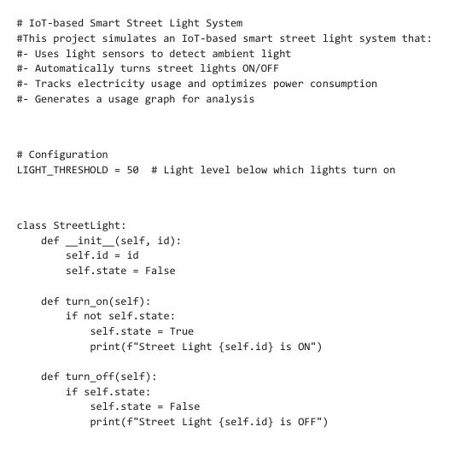
CODE

Slide 5
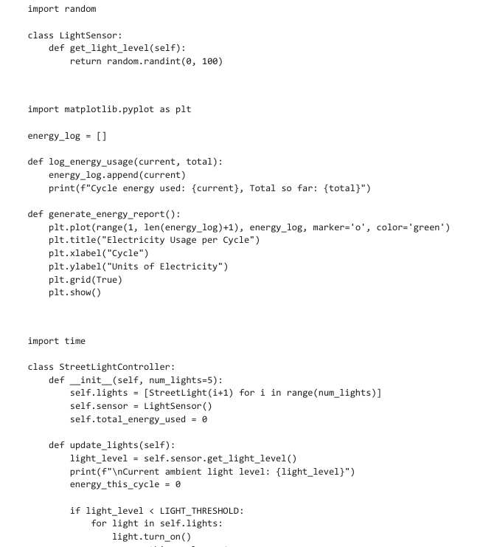

Slide 6
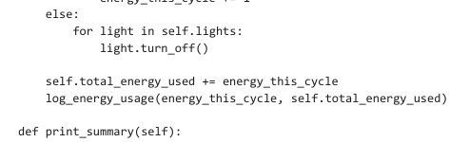
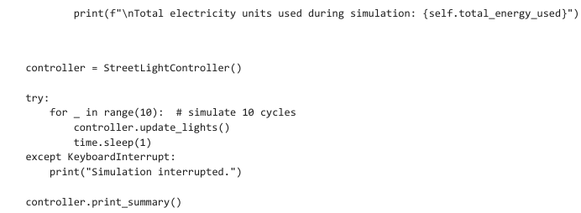

Slide 7
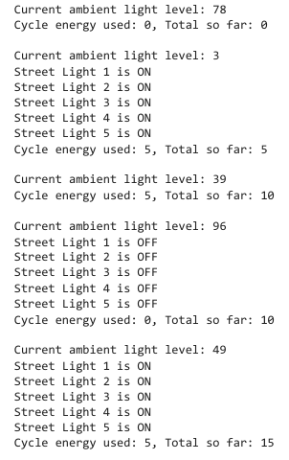

Slide 8
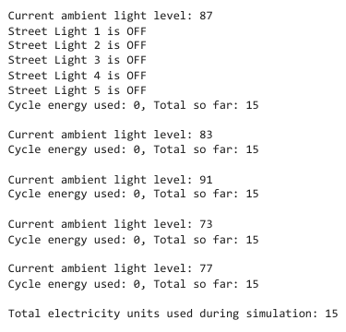

Slide 9
Code Explaination
a. Conditional Statements
Used to check if the light level is below the threshold:
Python:
if light_level < LIGHT_THRESHOLD:
# Turn lights ON
else:
# Turn lights OFF

Slide 10
b. Loops
Used to simulate multiple street lights and multiple update cycles:
Python:
for light in self.lights:
light.turn_on()
Python:
for _ in range(10):
controller.update_lights()

Slide 11
c. Object-Oriented Programming (OOP)
Classes like StreetLight, LightSensor, and StreetLightController organize the logic into reusable modules.
Objects represent real-world components like individual lights or a sensor.

Slide 12
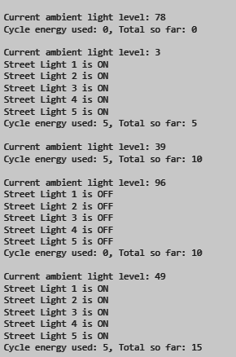
OUTPUT

Slide 13
